Slide 1
^{Chapter 6} Graphs
ZAMAN UNIVERSITY
Data Structures and Algorithms

Slide 2
Outline
Terminology and Representations
Graph Traversals
Shortest-Paths Problems
Minimum-Cost Spanning Trees

Slide 3
What is Graph?
Graphs provide the ultimate in data structure flexibility
Graphs can model both real-world systems and abstract problems
Here is a small sampling of the range of problems that graphs are applied to:
Modeling connectivity in computer and communications networks;
Representing a map as a set of locations with distances between locations; for computing shortest routes between locations;
Modeling flow capacities in transportation networks;
Finding a path from a starting condition to a goal condition; for example, in artificial intelligence problem solving;
Modeling computer algorithms, showing transitions from one program state to another;
And …

Slide 4
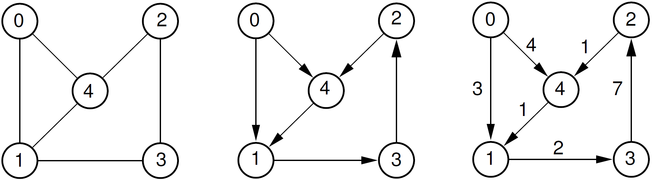
Example of Graphs
a. A Graph
b. A Directed Graph (Digraph)
c. A Weighted Graph

Slide 5
Outline
Terminology and Representations
Graph Traversals
Shortest-Paths Problems
Minimum-Cost Spanning Trees

Slide 6
Terminology
A graph G consist of
1. Set of vertices V (called nodes), V = {v₁, v₂, v₃, …,} and
2. Set of edges E (i.e., E={e₁, e₂, e₃, …})
Thus, a graph can be represents as G = (V, E), where V is a finite and non empty set at vertices and E is a set of pairs of vertices called edges.
Consider a graph G in Figure c, then the vertex V and edge E can be represented as: V={0, 1, 2, 3, 4} and E={(0,1), (0,4), (1,3), (3,2), (2,4), (4,1)}.

Slide 7
Representations
There are two standard ways of maintaining a graph G in the memory of a computer:
Sequential representation of a graph using adjacent;
Linked representation of a graph using linked list.

Slide 8
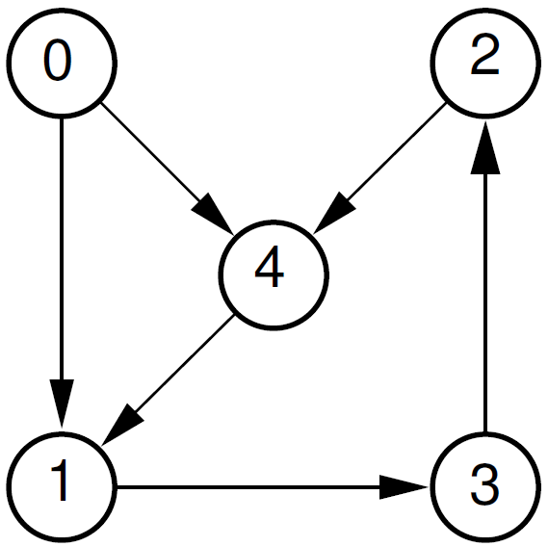
Adjacency Matrix Representation
Graph G = (V, E) with n vertices, is an n × n matrix.
The adjacency matrix A of a directed graph G can be represented with the following conditions:
A_{ij} = 1 {if there is an edge from V_{i} to V_{j} or if the edge (i, j) is member of E.}
A_{ij} = 0 {if there is no edge from V_{i} to V_{j}}
 | 0 | 1 | 2 | 3 | 4
0 | 0 | 1 | 0 | 0 | 1
1 | 0 | 0 | 0 | 1 | 0
2 | 0 | 0 | 0 | 0 | 1
3 | 0 | 0 | 1 | 0 | 0
4 | 0 | 1 | 0 | 0 | 0
A=

Slide 9
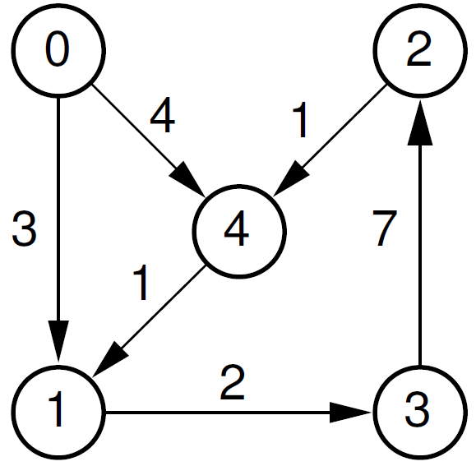
Adjacency Matrix Representation for Directed Weighted Graph
The adjacency matrix A for a directed weighted graph G = (V, E, W_{e} ) can be represented:
A_{ij} = W_{e} {if there is an edge from V_{i} to V_{j} then represent its weight W_{ij}}
A_{ij} = -1 {if there is no edge from V_{i} to V_{j}}
 | 0 | 1 | 2 | 3 | 4
0 | -1 | 3 | -1 | -1 | 4
1 | -1 | -1 | -1 | 2 | -1
2 | -1 | -1 | -1 | -1 | 1
3 | -1 | -1 | 7 | -1 | -1
4 | -1 | 1 | -1 | -1 | -1
A=

Slide 10
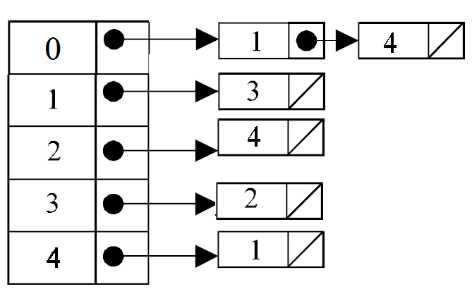
Linked List Representation
In this representation (also called adjacency list representation), graph is stored as linked structure.

Slide 11
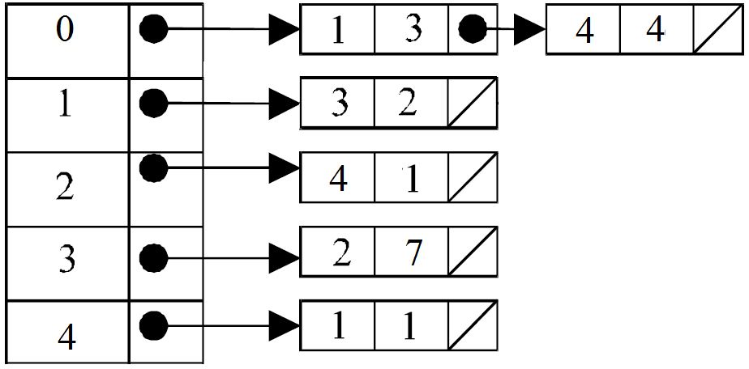
Linked List Representation for Direct Weighted Graph

Slide 12

12
Number of node is random or fixed and edges are also random.
Write a program to represent graph as Adjacent Matrix and Linked List

Slide 13
Outline
Terminology and Representations
Graph Traversals
Shortest-Paths Problems
Minimum-Cost Spanning Trees

Slide 14
Graph Traversals
As in tree, traversing a graph consists of visiting each vertex only one time
Simple traversal algorithms used for trees CANNOT be applied in graph, since graphs may include cycles, thus the tree traversal algorithms would result infinite loops.
To prevent this, for each visited vertex will be marked to avoid revisiting.

Slide 15
Outline
Terminology and Representations
Graph Traversals
Depth First Search
Breadth First Search
Shortest-Paths Problems
Minimum-Cost Spanning Trees

Slide 16
Graph Traversals: Depth First Search (s, G) - Iterative
Initialize: Set Stack = { s }, VisitedList = { }
Terminate if Stack is empty
Select a vertex, n, from Stack
Visit n and save n to VisitedList
Expand: Define Successors m of vertex n in G. For each successor, m, insert m in Stack only if m ∉ [ Stack ⋃ VisitedList ]
Loop: Go to step 2
Notes:
Recursive:
VisitedList = { }
DFS (s, G) Begin
Visit s and add s to VisitedList
For each successor m of s:
if m is NOT in VisitedList then
DFS( m, G )
End

Slide 17
Animation of Depth First Search
https://commons.wikimedia.org

Slide 18
Outline
Terminology and Representations
Graph Traversals
Depth First Search
Breadth First Search
Shortest-Paths Problems
Minimum-Cost Spanning Trees

Slide 19
Graph Traversals: Breadth First Search (s, G)
Initialize: Set Queue = { s }, VisitedList = { }
Terminate if Queue is empty
Select a vertex, n, from Queue
Visit n and save n to VisitedList
Expand: Define Successors m of vertex n in G. For each successor, m, insert m in Queue only if m ∉ [Queue ⋃ VisitedList ]
Loop: Go to step 2

Slide 20
Animation of Breadth First Search
https://commons.wikimedia.org

Slide 21
21
Write functions of Depth First Search and Breadth First Search based on pseudo-code in the slide.

Slide 22
To be continued…

